Slide 1
Verilog基础
硬核实战营培训
www.eefocus.com

Slide 2
关于Verilog及设计流程
Veriog代码结构 - 模块、端口、注释
常数、运算符

Slide 3
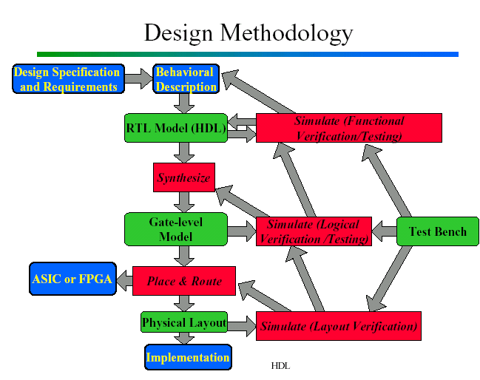
芯片设计流程
Specification
Behavioral description
RTL description
Functional verification & test
Logic synthesis
Gate level netlist
Logic verification and testing
Floor planning, auto place & route
Physical layout
Layout verification
Implementation

Slide 4
自上而下的层次化结构设计
顶层模块
子模块1
子模块2
基本模块1
基本模块2
基本模块3

Slide 5
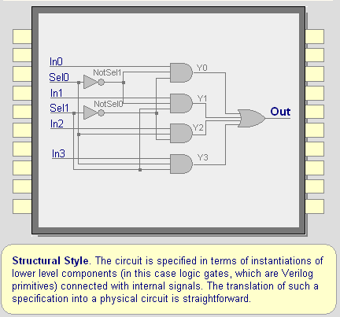
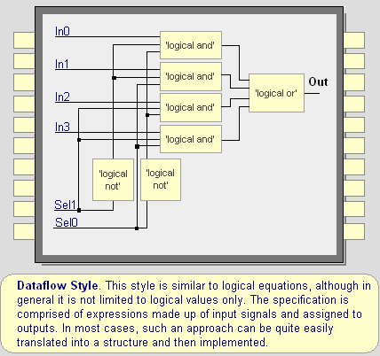
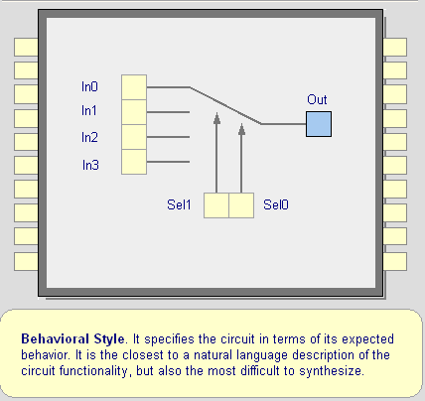
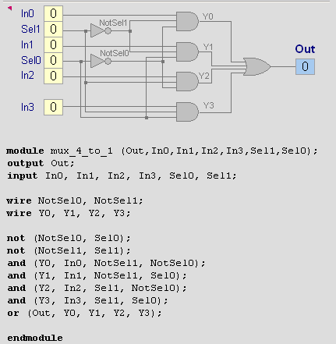
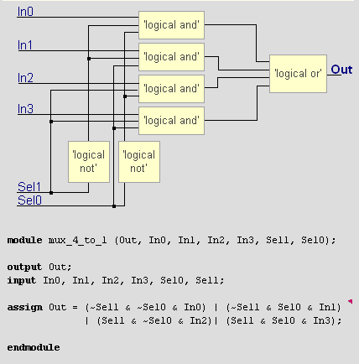
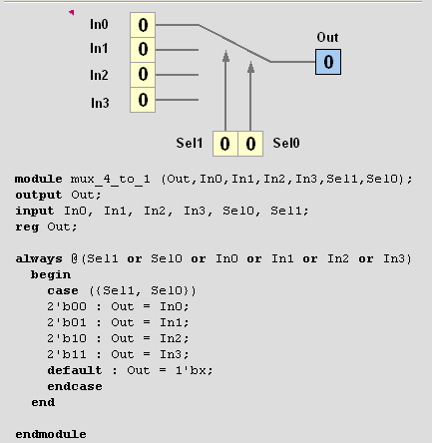
不同的设计方式
列出了一系列元件以及它们之间如何连接
纯结构化
就如原理图，但是用文字来描述
Specifies transfer of data between registers
Some structural information is available (RTL)
Sometimes similar to behavior
Procedural code, 类似C编程
描述一个元件的功能以及如何实现该功能
很少的结构化细节 (除了模块之间的互联)

Slide 6
模块
in1
my_module
out1
对应于电路中的一个元件
可以跟其它元件连接，并被多次引用
I/O端口在模块的顶部列出，被声明为Input、Output、或Inout（用于三态的总线中）
端口声明意味着变量都是Wires
in2
out2
f
inN
outM
module my_module(out1, .., inN);
output out1, .., outM;
input in1, .., inN;
.. // declarations
.. // description of f (maybe
.. // sequential)
endmodule
接口: 端口和参数声明
主体部分: 模块的内部部分
附加部分 (可选加)
模块的名字
标注：
一行标注 (// ………….)
一块标注 (/*…………….*/)
模块的描述(推荐的选项)

Slide 7
关键词
所有关键词都是用小写字母来定义
例如 :
module, endmodule
input, output, inout
reg, integer, real, time
not, and, nand, or, nor, xor
parameter
begin, end
fork, join
specify, h
module – Verilog设计中的基础块，用于构建设计中的层次化
endmodule – 结束一个模块，不是一个语句
Module Declaration
module module_name (module_port, module_port, …);
Example: module full_adder (A, B, c_in,c_out, S);
输入定义：
向量
input list of input identifiers;
例如: input A, B, c_in;
矢量
input[范围] list of input identifiers;
例如: input[15:0] A, B, data;
输出定义：
向量举例: output c_out, OV, MINUS;
矢量举例: output[7:0] ACC, REG_IN, data_out;

Slide 8
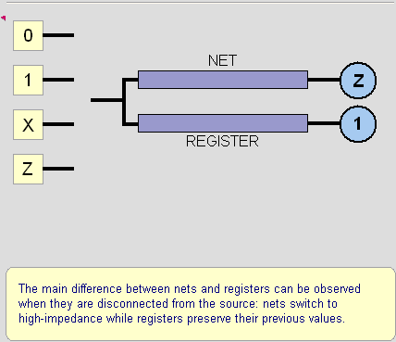
变量：wire/reg
Nets:
硬件单元之间的物理连接 - 用关键词 “wire”定义
不保留他们的值，它们的数值来自一个门或其它模块的驱动
不能通过一个initial 或 always 块进行赋值
Registers:
类似计算机里的存储器
在通过一个initial或always块赋值之前一直保留其数值
可以用来模型化锁存器、寄存器等，但不是完全对应

Slide 9
Verilog的数字表示
<位宽>’<基数> <值>
位数
2进制 → b或B
8进制 → o 或 O
10进制 → d or D
16进制 → h or H
连续的字符
0-f, x, z
8’h ax = 1010xxxx
12’o 3zx7 = 011zzzxxx11112’h046 - 12位长的16进制数
Verilog的数值是没有符号的：
例如：C[4:0] = A[3:0] + B[3:0];
if A = 0110 (6) and B = 1010(-6)
C = 10000 not 0000
i.e., B is zero-padded, not sign-extended

Slide 10
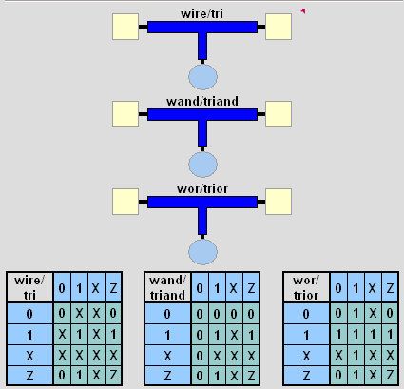
变量的多种形式
Wires和registers可以是位、向量以及数组
wire a; //一个简单的wire
tri [15:0] dbus; // 16-bit 三态总线
try #(5,4,8) b; // 带延迟的Wire
reg [-1:4] vec; // 6-bit的register（寄存器）
triage (small) q; // Wire stores a small charge
integer imem[0:1023]; // 1024整数的数组
reg [31:0] dcache[0:63]; // 一个32-bit 的存储器

Slide 11
数据值
四种数据的值
数据表示类型：
二进制： 6’b100101
十六进制： 6’h25
0: 零, 逻辑低电平，错误, 接地
1: 一, 逻辑高电平, 电源
X: 状态未知
Z: 高阻、三态、未连接,无驱动
多位数的向量
A[3:0] - 4 bits的向量: A[3], A[2], A[1], A[0]
被当成无符号的整数值
截断bits/vectors得到一个vector
B[7:0] = {A[3], A[3], A[3], A[3], A[3:0]};
B[7:0] = {4{A[3]}, A[3:0]};
建议的写法: a[7:0] = b[7:0] + c; 不建议的写法: a = b + c;

Slide 12
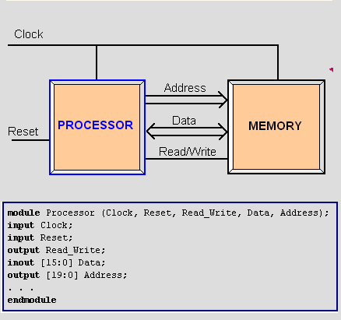
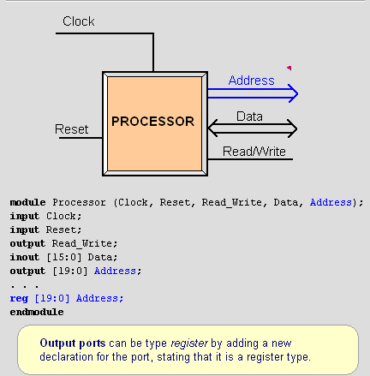
端口定义
寄存输出

Slide 13
时延声明和事件控制
延时声明
- 以一个#符号标明
- Delays the execution of the statement immediately after
- Inertial delay model (ignores glitches)
- Additive with blocking statements
事件控制声明：
- Edge sensitive, represented with a @ sign
- Delays the execution until expression transitions
Ex. always @(clock)
always @(posedge clock)
always @(a or b) - Level sensitive, represented with wait statement
Ex. always wait (enable) #20 cnt = cnt + 1;
传输延迟
单个延时: and #3 G1 (y,a,b,c);
上升/下降延时 and #(3,5) G2 (y,a,b)
Rise/Fall/Turnoff buff0 #(3,6.5) (y,x_in,en)
Rise/Fall/Turnoff with Min:typ:Max
buff1 #(3:4:5,4:5:6,7:8:9) (y,x_in,en);

Slide 14
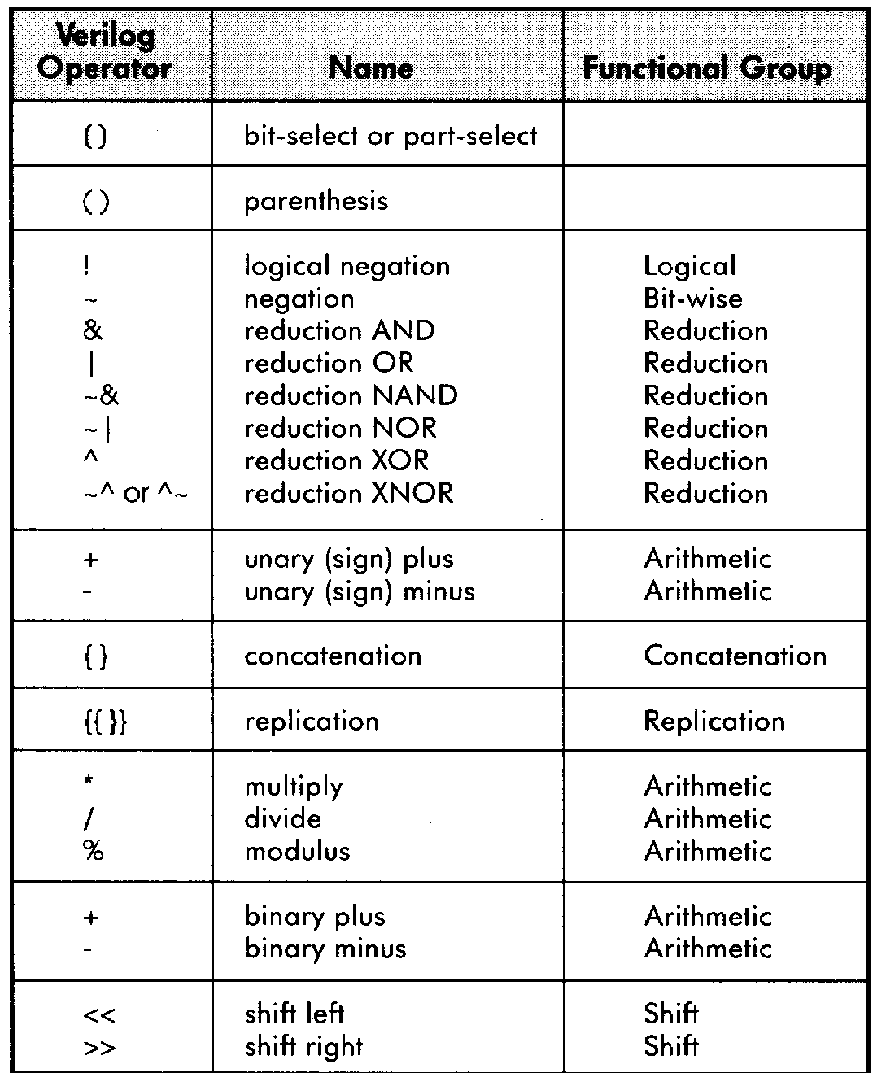
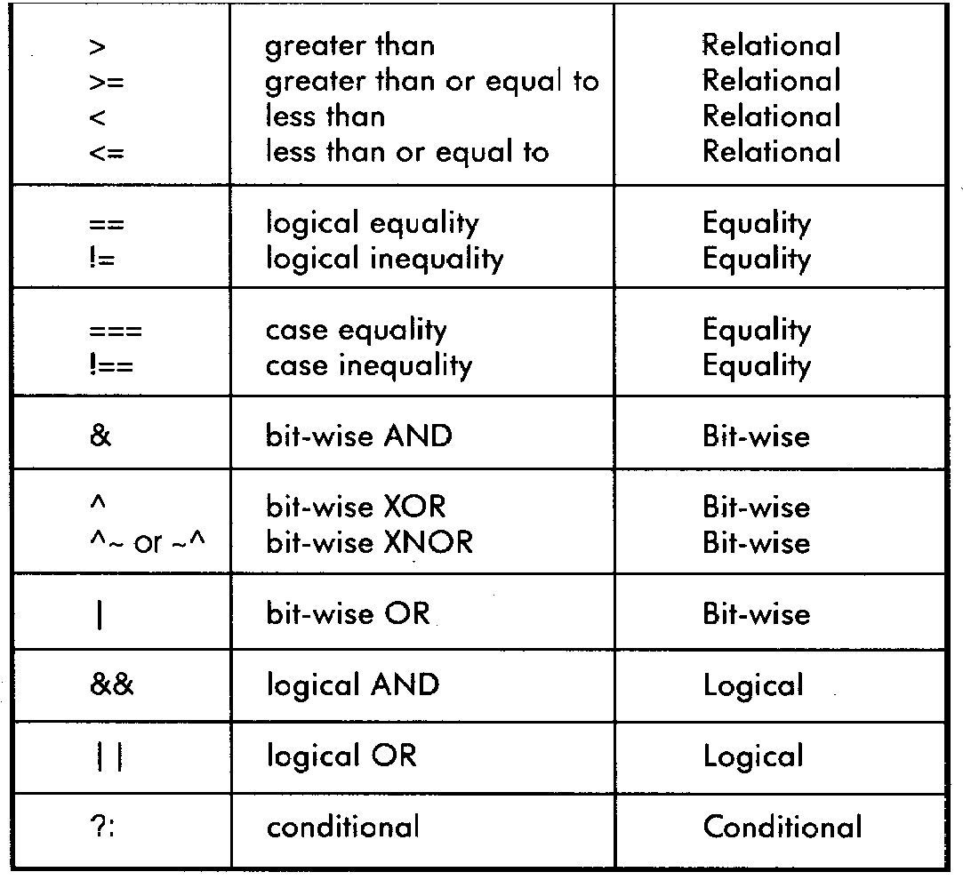
Verilog中的运算操作
位操作
逻辑运算
Reduction运算
算数运算
关系运算
移位运算

Slide 15
位操作 - 操作符
& → 位AND
| → 位OR
~ → 位NOT
^ → 位XOR
~^ or ^~ → 位XNOR

Slide 16
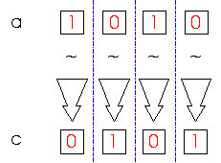
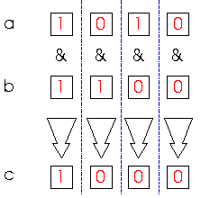
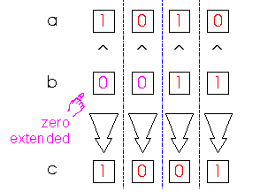
位操作 - 举例
c = ~a;
c = a & b;
a = 4’b1010;
b = 4’b1100;
c = a ^ b;
a = 4’b1010;
b = 2’b11;

Slide 17
逻辑运算
&& → 逻辑与 AND
|| → 逻辑或 OR
! → 逻辑非 NOT
Operands evaluated to ONE bit value: 0, 1 or x
Result is ONE bit value: 0, 1 or x
A = 1; A && B → 1 && 0 → 0
B = 0; A || !B → 1 || 1 → 1
C = x; C || B → x || 0 → x
but C&&B=0

Slide 18
移位及条件执行语句
>> → 右移
<< → 左移
a = 4’b1010;
d = a >> 2;// d = 0010,
c = a << 1;// c = 0100
cond_expr ? true_expr : false_expr
A
Y
B
Y = (sel)? A : B;
sel

Slide 19
举例 - 比较器
module Compare1 (A, B, Equal, Alarger, Blarger); input A, B; output Equal, Alarger, Blarger; assign Equal = (A & B) | (~A & ~B); assign Alarger = (A & ~B); assign Blarger = (~A & B); endmodule
// 通过4个1位的比较器构建一个4位的比较器 module Compare4(A4, B4, Equal, Alarger, Blarger); input [3:0] A4, B4; output Equal, Alarger, Blarger; wire e0, e1, e2, e3, Al0, Al1, Al2, Al3, B10, Bl1, Bl2, Bl3; Compare1 cp0(A4[0], B4[0], e0, Al0, Bl0); Compare1 cp1(A4[1], B4[1], e1, Al1, Bl1); Compare1 cp2(A4[2], B4[2], e2, Al2, Bl2); Compare1 cp3(A4[3], B4[3], e3, Al3, Bl3); assign Equal = (e0 & e1 & e2 & e3); assign Alarger = (Al3 | (Al2 & e3) |
(Al1 & e3 & e2) |
(Al0 & e3 & e2 & e1)); assign Blarger = (~Alarger & ~Equal); endmodule

Slide 20
Verilog持续赋值
use of Boolean operators (~ for bit-wise, ! for logical negation)
assign A = X | (Y & ~Z);
assign B[3:0] = 4'b01XX;
assign C[15:0] = 16'h00ff;
assign #3 {Cout, S[3:0]} = A[3:0] + B[3:0] + Cin;
bits can take on four values (0, 1, X, Z)
variables can be n-bits wide (MSB:LSB)
use of arithmetic operator
multiple assignment (concatenation)
delay of performing computation, only used by simulator, not synthesis

Slide 21
always block
always block
Always waiting for a change to a trigger signal
Then executes the body
Procedure that describes the function of a circuit
Can contain many statements including if, for, while, case
Statements in the always block are executed sequentially
(Continuous assignments <= are executed in parallel)
Entire block is executed at once
Final result describes the function of the circuit for current set of inputs
intermediate assignments don’t matter, only the final result
begin/end used to group statements
module and_gate (out, in1, in2); input in1, in2; output out; reg out; always @(in1 or in2) begin
out = in1 & in2;
end
endmodule
Not a real register!!
A Verilog register
Needed because of
assignment in always block
Specifies when block is executed I.e., triggered by which signals

Slide 22
未完成触发
省去一个输入触发信号一般会导致一个时序电路
例如: 这个”与”门的输出取决于输入的历史
module and_gate (out, in1, in2); input in1, in2; output out; reg out; always @(in1) begin
out = in1 & in2;
end
endmodule

Slide 23
If
// Simple 4:1 mux
module mux4 (sel, A, B, C, D, Y);
input [1:0] sel;// 2-bit control signal
input A, B, C, D;
output Y;
reg Y; // target of assignment
always @(sel or A or B or C or D)
if (sel == 2’b00) Y = A;
else if (sel == 2’b01) Y = B;
else if (sel == 2’b10) Y = C;
else if (sel == 2’b11) Y = D;
endmodule
另外一种方式
// Simple 4:1 mux
module mux4 (sel, A, B, C, D, Y);
input [1:0] sel; // 2-bit control signal
input A, B, C, D;
output Y;
reg Y; // target of assignment
always @(sel or A or B or C or D)
if (sel[0] == 0)
if (sel[1] == 0) Y = A;
else Y = B;
else
if (sel[1] == 0) Y = C;
else Y = D;
endmodule

Slide 24
Case - 1
顺序执行
只有第一个匹配的『case』被执行(implicit break)
缺省的case可以用到
// Simple 4-1 mux
module mux4 (sel, A, B, C, D, Y);
input [1:0] sel; // 2-bit control signal
input A, B, C, D;
output Y;
reg Y; // target of assignment
always @(sel or A or B or C or D)
case (sel)
2’b00: Y = A;
2’b01: Y = B;
2’b10: Y = C;
2’b11: Y = D;
endcase
endmodule
Conditions tested in top to bottom order

Slide 25
Case - 2
// Simple binary encoder (input is 1-hot)
module encode (A, Y);
input [7:0] A; // 8-bit input vector
output [2:0] Y; // 3-bit encoded output
reg [2:0] Y; // target of assignment
always @(A)
case (A)
8’b00000001: Y = 0;
8’b00000010: Y = 1;
8’b00000100: Y = 2;
8’b00001000: Y = 3;
8’b00010000: Y = 4;
8’b00100000: Y = 5;
8’b01000000: Y = 6;
8’b10000000: Y = 7;
default: Y = 3’bXXX; // Don’t care when input is not 1-hot
endcase
endmodule
// Priority encoder
module encode (A, Y);
input [7:0] A; // 8-bit input vector
output [2:0] Y; // 3-bit encoded output
reg [2:0] Y; // target of assignment
always @(A)
case (1’b1)
A[0]: Y = 0;
A[1]: Y = 1;
A[2]: Y = 2;
A[3]: Y = 3;
A[4]: Y = 4;
A[5]: Y = 5;
A[6]: Y = 6;
A[7]: Y = 7;
default: Y = 3’bXXX;// Don’t care when input is all 0’s
endcase
endmodule

Slide 26
Case - 3
// Priority encoder
module encode (A, valid, Y);
input [7:0] A; // 8-bit input vector
output [2:0] Y; // 3-bit encoded output
output valid; // Asserted when an input is not all 0’s
reg [2:0] Y; // target of assignment
reg valid;
always @(A) begin
valid = 1;
casex (A)
8’bXXXXXXX1: Y = 0;
8’bXXXXXX10: Y = 1;
8’bXXXXX100: Y = 2;
8’bXXXX1000: Y = 3;
8’bXXX10000: Y = 4;
8’bXX100000: Y = 5;
8’bX1000000: Y = 6;
8’b10000000: Y = 7;
default: begin
valid = 0;
Y = 3’bX; // Don’t care when input is all 0’s
end
endcase
end
endmodule
// simple encoder
module encode (A, Y);
input [7:0] A; // 8-bit input vector
output [2:0] Y; // 3-bit encoded output
reg [2:0] Y; // target of assignment
always @(A)
case (1’b1) // synthesis parallel-case
A[0]: Y = 0;
A[1]: Y = 1;
A[2]: Y = 2;
A[3]: Y = 3;
A[4]: Y = 4;
A[5]: Y = 5;
A[6]: Y = 6;
A[7]: Y = 7;
default: Y = 3’bX; // Don’t care when input is all 0’s
endcase
endmodule
Like case, but cases can include ‘X’
X bits not used when evaluating the cases
In other words, you don’t care about those bits!

Slide 27
For/repeat/forever
// simple encoder
module encode (A, Y);
input [7:0] A; // 8-bit input vector
output [2:0] Y; // 3-bit encoded output
reg [2:0] Y; // target of assignment
integer i; // Temporary variables for program only
reg [7:0] test;
always @(A) begin
test = 8b’00000001;
Y = 3’bX;
for (i = 0; i < 8; i = i + 1) begin
if (A == test) Y = i;
test = test << 1;
end
end
endmodule
while (expression) statement
Execute statement while expression is true
repeat (expression) statement
Execute statement a fixed number of times
forever statement
Execute statement forever

Slide 28
另一个Behavioral的例子
Computing Conway’s Game of Life rule
Cell with no neighbors or 4 neighbors dies; with 2-3 neighbors lives
module life (neighbors, self, out); input self; input [7:0] neighbors; output out; reg out; integer count; integer i; always @(neighbors or self) begin count = 0; for (i = 0; i<8; i = i+1) count = count + neighbors[i]; out = 0; out = out | (count == 3); out = out | ((self == 1) & (count == 2)); end endmodule
integers are temporary compiler variables
always block is executed instantaneously, if there are no delays only the final result is used

Slide 29
测试
Stimulus block
产生输出到设计的电路中
检查设计电路的输出
设计的电路
(CUD)
4
8
Test bench
Testbench
系统模型
激励
结果检查
响应

Slide 30
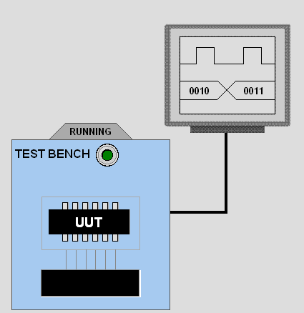
测试台(test bench)
module main;
reg a, b, c;
wire sum, carry;
fulladder add(a,b,c,sum,carry);
initial
begin
a = 0; b = 0; c = 0;
#5
a = 0; b = 1; c = 0;
#5
a = 1; b = 0; c = 1;
#5
a = 1; b = 1; c = 1;
#5
end
endmodule

Slide 31
测试模块的结构
module <test module name> ;
// 数据类型声明
// Instantiate module ( 调用被测试的模块)
// 施加激励
// 显示结果
endmodule
测试台产生输入激励信号，也经常包括对数据的观察
module stimulus;
reg clk;
reg reset;
wire[3:0] q;
// instantiate the design block
ripple_carry_counter r1(q, clk, reset);
// Control the clock
initial clk = 1'b0;
always #5 clk = ~clk;
// Control the reset
initial
begin
reset = 1'b1;
#15 reset = 1'b0;
#180 reset = 1'b1;
#10 reset = 1'b0;
#20 $stop;
end
// Monitor the outputs
initial
$monitor($time, " Output q = %d", q);
endmodule

Slide 32
仿真
仿真行为
Scheduled using an event queue
Non-preemptive, no priorities
A process must explicitly request a context switch
Events at a particular time unordered
Scheduler runs each event at the current time, possibly scheduling more as a result
Concurrent processes (initial, always) run until they stop at one of the followin
#42
Schedule process to resume 42 time units from now
wait(cf & of)
Resume when expression “cf & of” becomes true
@(a or b or y)
Resume when a, b, or y changes
@(posedge clk)
Resume when clk changes from 0 to 1
两种类型的事件
Evaluation events compute functions of inputs
Update events change outputs
Split necessary for delays, nonblocking assignments, etc.
Evaluation event reads values of b and c, adds them, and schedules an update event
Update event writes new value of a and schedules any evaluation events that are sensitive to a change on a
a <= b + c

Slide 33
仿真
Infinite loops are possible and the simulator does not check for them
This runs forever: no context switch allowed, so ready can never change
while (~ready)
count = count + 1;
Instead, use
wait(ready);
Semantics of the language closely tied to simulator implementation
Context switching behavior convenient for simulation, not always best way to model
Undefined execution order convenient for implementing event queue
Race conditions abound in Verilog
These can execute in either order: final value of a undefined:
always @(posedge clk) a = 0;
always @(posedge clk) a = 1;

Slide 34
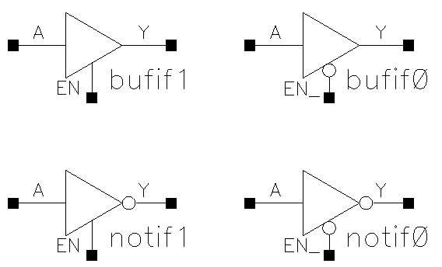
Verilog基本单元
只是基本的逻辑门
and
or
not
buf
xor
nand
nor
xnor
bufif1, bufif0
notif1, notif0

Slide 35
所有逻辑门的Verilog编码
module gates(a, b, y1, y2, y3, y4, y5, y6, y7);
input [3:0] a, b;
output [3:0] y1, y2, y3, y4, y5, y6, y7;
/* 7种不同的逻辑门工作于4位的总线上 */
assign y1= ~a; // NOT gate
assign y2= a & b; // AND gate
assign y3= a | b; // OR gate
assign y4= ~(a & b); // NAND gate
assign y5= ~(a | b); // NOR gate
assign y6= a ^ b; // XOR gate
assign y7= ~(a ^ b); // XNOR gate
endmodule

Slide 36
示例 - 加法器
A
S
A
S
module half_adder(S, C, A, B);
output S, C;
input A, B;
wire S, C, A, B;
assign S = A ^ B;
assign C = A & B;
endmodule
Half
Adder
B
B
C
C
in1
A
S
I1
A
S
sum
t
Half
Adder 1
ha1
Half
Adder
ha2
in2
B
C
I2
B
C
I3
cout
cin
module full_adder(sum, cout, in1, in2, cin);
output sum, cout;
input in1, in2, cin;
wire sum, cout, in1, in2, cin;
wire I1, I2, I3;
half_adder ha1(I1, I2, in1, in2);
half_adder ha2(sum, I3, I1, cin);
assign cout = I2 || I3;
endmodule
Instance
name
Module
name

Slide 37
举例: 全加器
in1
A
S
I1
A
S
sum
Half
Adder 1
ha1
Half
Adder
ha2
in2
B
C
I2
B
C
I3
cout
cin
module full_adder(sum, cout, in1, in2, cin);
output sum, cout;
input in1, in2, cin;
wire sum, cout, in1, in2, cin;
wire I1, I2, I3;
half_adder ha1(I1, I2, in1, in2);
half_adder ha2(sum, I3, I1, cin);
assign cout = I2 || I3;
endmodule
Instance
name
Module
name

Slide 38
赋值
Procedural Assignments
Blocking assignment statement (= operator) acts much like in traditional programming languages. The whole statement is done before control passes on to the next statement
Nonblocking assignment statement (<= operator) evaluates all the right-hand sides for the current time unit and assigns the left-hand sides at the end of the time unit
Continuous assignments assign values to nets (vector and scalar)
They are triggered whenever simulation causes the value of the right-hand side to change
Keyword “assign”
e.g. assign out = in1 & in2;
Procedural assignments drive values onto registers (vector and scalar)
They Occur within procedures such as always and initial
They are triggered when the flow of execution reaches them (like in C)
Blocking and Non-Blocking procedural assignments

Slide 39
基于延时的定时控制
Delay Control (#)
Expression specifies the time duration between initially encountering the statement and when the statement actually executes.
Delay in Procedural Assignments
Inter-Statement Delay
Intra-Statement Delay
For example:
Inter-Statement Delay
#10 A = A + 1;
Intra-Statement Delay
A = #10 A + 1;

Slide 40
时序表述： if/case
if (expr1)
true_stmt1;
else if (expr2)
true_stmt2;
..
else
def_stmt;
case (expr)
item_1, .., item_n: stmt1;
item_n+1, .., item_m: stmt2;
..
default: def_stmt;
endcase
带使能控制的3-to 8译码
module decoder(o,enb_,sel) ;
output [7:0] o ;
input enb_ ;
input [2:0] sel ;
reg [7:0] o ;
always @ (enb_ or sel)
if(enb_)
o = 8'b1111_1111 ;
else
case(sel)
3'b000 : o = 8'b1111_1110 ;
3'b001 : o = 8'b1111_1101 ;
3'b010 : o = 8'b1111_1011 ;
3'b011 : o = 8'b1111_0111 ;
3'b100 : o = 8'b1110_1111 ;
3'b101 : o = 8'b1101_1111 ;
3'b110 : o = 8'b1011_1111 ;
3'b111 : o = 8'b0111_1111 ;
default : o = 8'bx ;
endcase
endmodule
E.g. 4-to-1 mux:
module mux4_1(out, in, sel);
output out;
input [3:0] in;
input [1:0] sel;
reg out;
wire [3:0] in;
wire [1:0] sel;
always @(in or sel)
if (sel == 0)
out = in[0];
else if (sel == 1)
out = in[1];
else if (sel == 2)
out = in[2];
else
out = in[3];
endmodule
E.g. 4-to-1 mux:
module mux4_1(out, in, sel);
output out;
input [3:0] in;
input [1:0] sel;
reg out;
wire [3:0] in;
wire [1:0] sel;
always @(in or sel)
case (sel)
0: out = in[0];
1: out = in[1];
2: out = in[2];
3: out = in[3];
endcase
endmodule

Slide 41
矢量
Nets and Registers can be declared as vectors
If no bitwidth is specified, 1 bit is assumed
wire [7:0] a;
reg [0:31] addr1, addr2;
Subsets of bits can be selected
addr1[2:0] = addr2[3:1];

Slide 42
其它数据类型
Verilog allows integers, real, and time types
Arrays can be made from other types
- Arrays can be multidimensional
- A vector is conceptually a single elements with many bits
- An array is many elements put together
wire [7:0] x; // a vector
wire x [7:0]; // an array
wire [7:0] x [7:0]; // an array of vectors
wire x[7:0][7:0]; // a two dimensional array
Parameters are constants
parameter line_width=80;

Slide 43
Dataflow Descriptions, Continuous Assignments
assign out = i1 & i2;
module edge_dff(q, qbar, d, clk, clear);
// Inputs and outputs
output q,qbar;
input d, clk, clear;
// Internal variables
wire s, sbar, r, rbar,cbar;
//Make complement of clear
assign cbar = ~clear;
Use the assign keyword (in most cases)
Left hand side must be a net of some kind (scalar or vector), not a register
Right hand side can be registers, nets, or function calls
Continuous assignments are always active. Execution hard to trace
They are evaluated whenever a right hand side operand changes value
Delays (inertial) can be added to represent component delays
assign #10 out = i1 & i2;
// Input latches
assign sbar = ~(rbar & s),
s = ~(sbar & cbar & ~clk),
r = ~(rbar & ~clk & s),
rbar = ~(r & cbar & d);
// Output latch
assign q = ~(s & qbar),
qbar = ~(q & r & cbar);
endmodule
Continuous assignment can be implicit in a net declaration
wire out = i1 & i2;

Slide 44
Behavioral Modeling, Structured Procedures
Always blocks and initial blocks
- Parallel constructs: all blocks can execute in parallel
Initial blocks
- The block executes only once
- By default, starts at time 0 (but this can be changed)
- Often used for initialization
Always blocks
- The block executes in an infinite loop
- By default, starts at time 0 (but this can be changed)
- Represents a concurrent hardware block
- Needs a delay
module stimulus;
reg x,y, a,b, m;
initial
begin
#5 a = 1'b1;
#25 b = 1'b0;
end
initial
begin
#10 x = 1'b0;
#25 y = 1'b1;
end
endmodule
always
begin
… imperative statements …
end
Runs when simulation starts
Restarts when control reaches the end
Good for modeling/specifying hardware
module clock_gen;
reg clock;
initial
clock = 1'b0;
always
#10 clock = ~clock;
initial
#1000 $finish;
endmodule
initial
begin
… imperative statements …
end
Runs when simulation starts
Terminates when control reaches the end
Good for providing stimulus

Slide 45
Initial and Always
Run until they encounter a delay
initial begin
#10 a = 1; b = 0;
#10 a = 0; b = 1;
end
or a wait for an event
always @(posedge clk) q = d;
always begin wait(i); a = 0; wait(~i); a = 1; end

Slide 46
Procedural Statements
Verilog has two types of procedural assignment
Fundamental problem:
In a synchronous system, all flip-flops sample simultaneously
In Verilog, always @(posedge clk) blocks run in some undefined sequence
Non-Blocking Assignments
- Represented with a <= sign
- All non-blocking assignments are executed in parallel
- Try not to mix with blocking assignments
Blocking Assignments
- Represented with a = sign
- All blocking assignments are executed in sequence
module dummy;
reg x, y, z;
reg [15:0] reg_a, reg_b;
integer count;
initial
begin
x = 0; y = 1; z = 1;
count = 0;
reg_a = 16'b0;
reg_b = reg_a;
reg_a[2] = #15 1;
reg_b[15:13] = #10 {x, y, z};
count = count + 1;
end
module dummy;
reg x, y, z;
reg [15:0] reg_a, reg_b;
integer count;
initial
begin
x = 0; y = 1; z = 1;
count = 0;
reg_a = 16'b0;
reg_b = reg_a;
reg_a[2] <= #15 1;
reg_b[15:13] <= #10 {x, y, z};
count = count + 1;
end

Slide 47
时序电路设计
Inputs
Outputs
Combinational
circuit
Memory
elements
a feedback path
the state of the sequential circuits
the state transition
synchronous circuits
asynchronous circuits
Examples-D latch
D flip-flop
register

Slide 48
Two Main Components of Verilog
Concurrent, event-triggered processes (behavioral)
Initial and Always blocks
Imperative code that can perform standard data manipulation tasks (assignment, if-then, case)
Processes run until they delay for a period of time or wait for a triggering event
Structure (Plumbing)
Verilog program build from modules with I/O interfaces
Modules may contain instances of other modules
Modules contain local signals, etc.
Module configuration is static and all run concurrently

Slide 49
Multiplexer Built With Always
module mux(f, a, b, sel);
output f;
input a, b, sel;
reg f;
always @(a or b or sel)
if (sel) f = a;
else f = b;
endmodule
Modules may contain one or more always blocks
Sensitivity list contains signals whose change triggers the execution of the block
a
f
b
sel

Slide 50
Multiplexer Built With Always
module mux(f, a, b, sel);
output f;
input a, b, sel;
reg f;
always @(a or b or sel)
if (sel) f = a;
else f = b;
endmodule
A reg behaves like memory: holds its value until imperatively assigned otherwise
Body of an always block contains traditional imperative code
a
f
b
sel

Slide 51
Mux with Continuous Assignment
module mux(f, a, b, sel);
output f;
input a, b, sel;
assign f = sel ? a : b;
endmodule
LHS is always set to the value on the RHS
Any change on the right causes reevaluation
a
f
b
sel

Slide 52
Mux with User-Defined Primitive
primitive mux(f, a, b, sel);
output f;
input a, b, sel;
table
1?0 : 1;
0?0 : 0;
?11 : 1;
?01 : 0;
11? : 1;
00? : 0;
endtable
endprimitive
Behavior defined using a truth table that includes “don’t cares”
This is a less pessimistic than others: when a & b match, sel is ignored
(others produce X)
a
f
b
sel

Slide 53
Structural Modeling

Slide 54
Modules and Instances
Basic structure of a Verilog module:
module mymod(output1, output2, … input1, input2);
output output1;
output [3:0] output2;
input input1;
input [2:0] input2;
…
endmodule
Verilog convention lists outputs first

Slide 55
Instantiating a Module
Instances of
module mymod(y, a, b);
look like
mymod mm1(y1, a1, b1); // Connect-by-position
mymod (y2, a1, b1),
(y3, a2, b2); // Instance names omitted
mymod mm2(.a(a2), .b(b2), .y(c2)); // Connect-by-name

Slide 56
A Sequential Primitive
Primitive dff( q, clk, data);
output q; reg q;
input clk, data;
table
// clk data q new-q
(01) 0 : ? : 0; // Latch a 0
(01) 1 : ? : 1; // Latch a 1
(0x) 1 : 1 : 1; // Hold when d and q both 1
(0x) 0 : 0 : 0; // Hold when d and q both 0
(?0) ? : ? : -; // Hold when clk falls
? (??) : ? : -; // Hold when clk stable
endtable
endprimitive

Slide 57
Continuous Assignment
Another way to describe combinational function
Convenient for logical or datapath specifications
wire [8:0] sum;
wire [7:0] a, b;
wire carryin;
assign sum = a + b + carryin;
Define bus widths
Continuous assignment: permanently sets the value of sum to be a+b+carryin
Recomputed when a, b, or carryin changes

Slide 58
Imperative Statements
if (select == 1) y = a;
else y = b;
case (op)
2’b00: y = a + b;
2’b01: y = a – b;
2’b10: y = a ^ b;
default: y = ‘hxxxx;
endcase

Slide 59
Loops
For Loops
While Loops
A increasing sequence of values on an output
reg [3:0] i, output;
i = 0;
while (I <= 15) begin
output = i;
#10 i = i + 1;
end
A increasing sequence of values on an output
reg [3:0] i, output;
for ( i = 0 ; i <= 15 ; i = i + 1 ) begin
output = i;
#10;
end

Slide 60
计数器举例
module Div20x (rst, clk, cet, cep, count, tc);
// TITLE 'Divide-by-20 Counter with enables'
// enable CEP is a clock enable only
// enable CET is a clock enable and
// enables the TC output
// a counter using the Verilog language
parameter size = 5;
parameter length = 20;
input rst; // These inputs/outputs represent
input clk; // connections to the module.
input cet;
input cep;
output [size-1:0] count;
output tc;
reg [size-1:0] count; // Signals assigned
// within an always
// (or initial)block
// must be of type reg
wire tc; // Other signals are of type wire
// The always statement below is a parallel
// execution statement that
// executes any time the signals
// rst or clk transition from low to high
always @ (posedge clk or posedge rst)
if (rst) // This causes reset of the cntr
count <= {size{1'b0}};
else
if (cet && cep) // Enables both true
begin
if (count == length-1)
count <= {size{1'b0}};
else
count <= count + 1'b1;
end
// the value of tc is continuously assigned
// the value of the expression
assign tc = (cet && (count == length-1));
endmodule
...
reg a, b, c, d;
wire e;
...
always @(b or e)
begin
a = b & e;
b = a | b;
#5 c = b;
d = #6 c ^ e;
end
The always clause above illustrates the other type of method of use, i.e. it executes whenever any of the entities in the list (the b or e) changes. When one of these changes, a is immediately assigned a new value, and due to the blocking assignment, b is assigned a new value afterward (taking into account the new value of a). After a delay of 5 time units, c is assigned the value of b and the value of c ^ e is tucked away in an invisible store. Then after 6 more time units, d is assigned the value that was tucked away.
Signals that are driven from within a process (an initial or always block) must be of type reg. Signals that are driven from outside a process must be of type wire. The keyword reg does not necessarily imply a hardware register.

